Slide 1
Concurrency Control
Slides taken from Mohammad Hammoud (CMU, Qatar).

Slide 2
Concurrent Execution of Programs
A database is typically shared by a large number of users
DBMSs schedule users’ programs concurrently
While one user program is waiting for an I/O access to be satisfied, the CPU can process another program
Better system throughput
Interleaved executions of short and long programs allow the short program to complete quickly
Better response time
Fairer
Notes:
In step 2, the combination of all Query optimization is one of the most important tasks of a relational DBMS
is used as a key for sorting.

Slide 3
Transactions
Any one execution of a user program in a DBMS is denoted as a transaction
Executing the same program several times will generate several transactions
A transaction is the basic unit of change as seen by a DBMS
E.g., Transfer $100 from account A to account B
A transaction may carry out many operations on data, but DBMSs are only concerned about reads and writes
Thus, in essence a transaction becomes a sequence of reads and writes
Notes:
In step 2, the combination of all Query optimization is one of the most important tasks of a relational DBMS
is used as a key for sorting.

Slide 4
Transactions (Cont’d)
In addition to reading and writing, a transaction must specify as its final action:
Either Commit (i.e., complete successfully)
Or Abort (i.e., terminate and undo actions)
We make two assumptions:
Transactions interact only via database reads and writes (i.e., no message passing)
A database is a fixed collection of independent objects (A, B, C, etc.)
Notes:
In step 2, the combination of all Query optimization is one of the most important tasks of a relational DBMS
is used as a key for sorting.

Slide 5
Schedules
A schedule is a list of actions (i.e., read, write, abort, and/or commit) from a set of transactions
The order in which two actions of a transaction T appear in a schedule must be the same as they appear in T itself
Assume T1 = [R(A), W(A)] and T2 = [R(B), W(B), R(C), W(C)]
T1
T2
T1
T2
T1
T2
R(A)
W(A)
R(B)
W(B)
R(C)
W(C)
R(A)
W(A)
R(B)
W(B)
R(C)
W(C)
R(A)
W(A)
R(C)
W(C)
R(B)
W(B)
Notes:
In step 2, the combination of all Query optimization is one of the most important tasks of a relational DBMS
is used as a key for sorting.

Slide 6
Serial Schedules
A complete schedule must contain all the actions of every transaction that appears on it
If the actions of different transactions are not interleaved, the schedule is called a serial schedule
T1
T2
T1
T2
R(A)
W(A)
Commit
R(A)
W(A)
R(C)
W(C)
Commit
R(B)
W(B)
R(C)
W(C)
Commit
R(A)
W(A)
Commit
A Serial Schedule
A Non-Serial Schedule
Notes:
In step 2, the combination of all Query optimization is one of the most important tasks of a relational DBMS
is used as a key for sorting.

Slide 7
Serializable Schedules
Two schedules are said to be equivalent if for any database state, the effect of executing the 1st schedule is identical to the effect of executing the 2nd schedule
A serializable schedule is a schedule that is equivalent to a serial schedule
T1
T2
T1
T2
T1
T2
R(A)
W(A)
R(B)
W(B)
Commit
R(A)
W(A)
R(B)
W(B)
Commit
R(A)
W(A)
R(B)
W(B)
Commit
R(A)
W(A)
R(B)
W(B)
Commit
R(A)
W(A)
R(B)
W(B)
Commit
R(A)
W(A)
R(B)
W(B)
Commit
Equivalent
Equivalent
A Serializable Schedule
A Serial Schedule
Another Serializable Schedule
Notes:
In step 2, the combination of all Query optimization is one of the most important tasks of a relational DBMS
is used as a key for sorting.

Slide 8
Examples
Assume transactions T1 and T2 as follows:
T1 can be thought of as transferring $100 from A’s account to B’s account
T2 can be thought of as crediting accounts A and B with a 6% interest payment
T1: BEGIN A=A-100, B=B +100 END
T2: BEGIN A=1.06*A, B=1.06*B END
Notes:
In step 2, the combination of all Query optimization is one of the most important tasks of a relational DBMS
is used as a key for sorting.

Slide 9
Examples: A Serial Schedule
Assume transactions T1 and T2 as follows:
T1: BEGIN A=A-100, B=B +100 END
T2: BEGIN A=1.06*A, B=1.06*B END
T1: Transfer $100 from A to B
T2 = Add interest of 6% to A and B
3
1
2
Bal=1160
Bal=960
Bal=1060
Bal=1000
Bal=1060
4
Bal=1000
Account A
Account B
Notes:
In step 2, the combination of all Query optimization is one of the most important tasks of a relational DBMS
is used as a key for sorting.

Slide 10
Examples: Another Serial Schedule
Assume transactions T1 and T2 as follows:
T1: BEGIN A=A-100, B=B +100 END
T2: BEGIN A=1.06*A, B=1.06*B END
T1: Transfer $100 from A to B
T2 = Add interest of 6% to A and B
1
3
Bal=1000
4
Bal=1166
Bal=900
Bal=954
2
Bal=1000
Bal=1100
Previously:
Account A = 960
Account B = 1160
Account A
Account B
Notes:
In step 2, the combination of all Query optimization is one of the most important tasks of a relational DBMS
is used as a key for sorting.

Slide 11
Examples: A Serializable Schedule
Assume transactions T1 and T2 as follows:
T1: BEGIN A=A-100, B=B +100 END
T2: BEGIN A=1.06*A, B=1.06*B END
T1: Transfer $100 from A to B
T2 = Add interest of 6% to A and B
1
4
Bal=1000
2
Bal=1166
Bal=900
Bal=954
3
Bal=1000
Bal=1100
A Previous Serial Schedule:
Account A = 954
Account B = 1166
Account A
Account B
Notes:
In step 2, the combination of all Query optimization is one of the most important tasks of a relational DBMS
is used as a key for sorting.

Slide 12
Comments
There is no guarantee that T1 will execute before T2 or vice-versa, if both are submitted together
However, the net effect must be equivalent to these two transactions running serially in some order
Executing transactions serially in different orders may produce different results, but they are all acceptable!
The DBMS makes no guarantees about which result will be the outcome of an interleaved execution
Notes:
In step 2, the combination of all Query optimization is one of the most important tasks of a relational DBMS
is used as a key for sorting.

Slide 13
Anomalies
Interleaving actions of different transactions can leave the database in an inconsistent state
Two actions on the same data object are said to conflict if at least one of them is a write
There are 3 anomalies that can arise upon interleaving actions of different transactions (say, T1 and T2):
Write-Read (WR) Conflict: T2 reads a data object previously written by T1
Read-Write (RW) Conflict: T2 writes a data object previously read by T1
Write-Write (WW) Conflict: T2 writes a data object previously written by T1
Notes:
In step 2, the combination of all Query optimization is one of the most important tasks of a relational DBMS
is used as a key for sorting.

Slide 14
Reading Uncommitted Data: WR Conflicts
WR conflicts arise when transaction T2 reads a data object A that has been modified by another transaction T1, which has not yet committed
Such a read is called a dirty read
Assume T1 and T2 such that:
T1 transfers $100 from A’s account to B’s account
T2 credits accounts A and B with a 6% interest payment
T1: BEGIN A=A-100, B=B +100 END
T2: BEGIN A=1.06*A, B=1.06*B END
Notes:
In step 2, the combination of all Query optimization is one of the most important tasks of a relational DBMS
is used as a key for sorting.

Slide 15
Reading Uncommitted Data: WR Conflicts
Suppose that T1 and T2 actions are interleaved as follows:
T1 deducts $100 from account A
T2 adds 6% interest to accounts A and B
T1 credits $100 to account B
T1: Transfer $100 from A to B
T2 = Add interest of 6% to A and B
Bal=1000
Bal=1000
Account A
Account B
Notes:
In step 2, the combination of all Query optimization is one of the most important tasks of a relational DBMS
is used as a key for sorting.

Slide 16
Reading Uncommitted Data: WR Conflicts
Suppose that T1 and T2 actions are interleaved as follows:
T1 deducts $100 from account A
T2 adds 6% interest to accounts A and B
T1 credits $100 to account B
1
2 and 3
4
T1: Transfer $100 from A to B
T2 = Add interest of 6% to A and B
1
2
Bal=1000
3
Bal=900
Bal=954
4
Bal=1000
Bal=1160
Bal=1060
Different than any serial schedule. (I.e., Neither: [A = 954 and B = 1166]
Nor: [A = 960 and B = 1160])
Account A
Account B
Notes:
In step 2, the combination of all Query optimization is one of the most important tasks of a relational DBMS
is used as a key for sorting.

Slide 17
Reading Uncommitted Data: WR Conflicts
T1 and T2 can be represented by the following schedule:
T1
T2
R(A)
W(A)
R(B)
W(B)
Commit
R(A)
W(A)
R(B)
W(B)
Commit
The value of A written by T1 is read by T2 before T1 has completed all its changes!
Why is this a problem?
Notes:
In step 2, the combination of all Query optimization is one of the most important tasks of a relational DBMS
is used as a key for sorting.

Slide 18
Reading Uncommitted Data: WR Conflicts
T1 and T2 can be represented by the following schedule:
T1
T2
R(A)
W(A)
R(B)
W(B)
Commit
R(A)
W(A)
R(B)
W(B)
Commit
The value of A written by T1 is read by T2 before T1 has completed all its changes!
Why is this a problem?
T1 may write some value into A that makes the database inconsistent
As long as T1 overwrites this value with a ‘correct’ value of A before committing, no harm is done if T1 and T2 are run in some serial order (this is because T2 would then not see the temporary inconsistency)
Notes:
In step 2, the combination of all Query optimization is one of the most important tasks of a relational DBMS
is used as a key for sorting.

Slide 19
Reading Uncommitted Data: WR Conflicts
T1 and T2 can be represented by the following schedule:
T1
T2
R(A)
W(A)
R(B)
W(B)
Commit
R(A)
W(A)
R(B)
W(B)
Commit
The value of A written by T1 is read by T2 before T1 has completed all its changes!
Why is this a problem?
Note that although a transaction must leave a database in a consistent state after it completes, it is not required to keep the database consistent while it is still in progress!
Notes:
In step 2, the combination of all Query optimization is one of the most important tasks of a relational DBMS
is used as a key for sorting.

Slide 20
Unrepeatable Reads: RW Conflicts
RW conflicts arise when transaction T2 writes a data object A that has been read by another transaction T1, while T1 is still in progress
If T1 tries to read A again, it will get a different result!
Such a read is called an unrepeatable read
Assume A is the number of available copies for a book
A transaction that places an order on the book reads A, checks that A > 0 and decrements A
Assume two transactions, T1 and T2
Notes:
In step 2, the combination of all Query optimization is one of the most important tasks of a relational DBMS
is used as a key for sorting.

Slide 21
Unrepeatable Reads: RW Conflicts
Suppose that T1 and T2 actions are interleaved as follows:
T1 reads A
T2 reads A, decrements A and commit
T1 tries to decrement A
T1: Places an order on a book of quantity A
T2 = Places an order on a book of quantity A
1: Read A = 1
2: Read A = 1
A=1
4: Decrement A = ERROR!
A=0
3: Decrement A & Commit
This situation will never arise in a serial execution of T1 and T2; T2 would read A and see 0 and therefore not proceed with placing an order!
Notes:
In step 2, the combination of all Query optimization is one of the most important tasks of a relational DBMS
is used as a key for sorting.

Slide 22
Overwriting Uncommitted Data: WW Conflicts
WW conflicts arise when transaction T2 writes a data object A that has been written by another transaction T1, while T1 is still in progress
Suppose that Mohammad and Ahmad are two employees and their salaries must be kept equal
Assume T1 sets Mohammad’s and Ahmad’s salaries to $1000
Assume T2 sets Mohammad’s and Ahmad’s salaries to $2000
Notes:
In step 2, the combination of all Query optimization is one of the most important tasks of a relational DBMS
is used as a key for sorting.

Slide 23
Overwriting Uncommitted Data: WW Conflicts
T1: Sets Salaries to $1000
T2 = Sets Salaries to $2000
3
1
MS=0
2
AS=2000
MS=1000
4
AS=1000
MS=2000
AS=0
Mohammad’s Salary
Ahmad’s Salary
Notes:
In step 2, the combination of all Query optimization is one of the most important tasks of a relational DBMS
is used as a key for sorting.

Slide 24

Overwriting Uncommitted Data: WW Conflicts
T1: Sets Salaries to $1000
T2 = Sets Salaries to $2000
1
3
MS=2000
4
MS=0
MS=1000
2
AS=1000
AS=0
AS=2000
Mohammad’s Salary
Ahmad’s Salary
Either serial schedule is acceptable from a consistency standpoint (although Mohammad and Ahmad may prefer higher salaries!)
Neither T1 nor T2 reads a salary value before writing it- such a write is called a blind write!
Notes:
In step 2, the combination of all Query optimization is one of the most important tasks of a relational DBMS
is used as a key for sorting.

Slide 25
Overwriting Uncommitted Data: WW Conflicts
T1: Sets Salaries to $1000
T2 = Sets Salaries to $2000
1
2
MS=2000
4
MS=0
MS=1000
3
AS=2000
AS=1000
AS=0
Mohammad’s Salary
Ahmad’s Salary
The problem is that we have a lost update. In particular, T2 overwrote Mohammad’s Salary as set by T1 (this will never happen with a serializable schedule!)
Notes:
In step 2, the combination of all Query optimization is one of the most important tasks of a relational DBMS
is used as a key for sorting.

Slide 26
Implementation of Isolation Levels
Locking
Lock on whole database vs lock on items
How long to hold lock?
Shared vs exclusive locks
Timestamps
Transaction timestamp assigned e.g. when a transaction begins
Data items store two timestamps
Read timestamp
Write timestamp
Timestamps are used to detect out of order accesses
Multiple versions of each data item
Allow transactions to read from a “snapshot” of the database

Slide 27
Lock-Based Protocols
WR, RW and WW anomalies can be avoided using a locking protocol
A lock is a mechanism to control concurrent access to a data item
Data items can be locked in two modes :
1. exclusive (X) mode. Data item can be both read as well as
written. X-lock is requested using lock-X instruction.
2. shared (S) mode. Data item can only be read. S-lock is
requested using lock-S instruction.
Lock requests are made to concurrency-control manager. Transaction can proceed only after request is granted.
The part of the DBMS that keeps track of locks is called the lock manager

Slide 28
Lock Manager Implementation
Usually, a lock manager in a DBMS maintains three types of data structures:
A queue, Q, for each lock, L, to hold its pending requests
A lock table, which keeps for each L associated with each object, O, a record R that contains:
The type of L (e.g., shared or exclusive)
The number of transactions currently holding L on O
A pointer to Q
A transaction table, which maintains for each transaction, T, a pointer to a list of locks held by T
Transaction Table
Transaction List 1 (LS1)
Trx | List
T1 | LS1
Lock Queue 1 (Q1)
Lock Table
Object | Lock # | Type | # of Trx | Q
O | L | S | 1 | Q1
Notes:
In step 2, the combination of all Query optimization is one of the most important tasks of a relational DBMS
is used as a key for sorting.

Slide 29
Lock-Based Protocols (Cont.)
Lock-compatibility matrix
A transaction may be granted a lock on an item if the requested lock is compatible with locks already held on the item by other transactions
Any number of transactions can hold shared locks on an item,
But if any transaction holds an exclusive on the item, no other transaction may hold any lock on the item.
Notes:
If a lock cannot be granted, the requesting transaction is made to wait till all incompatible locks held by other transactions have been released. The lock is then granted.

Slide 30
Lock-Based Protocols (Cont.)
Example of a transaction performing locking:
T₂: lock-S(A);
read (A);
unlock(A);
lock-S(B);
read (B);
unlock(B);
display(A+B)
Locking as above is not sufficient to guarantee serializability

Slide 31
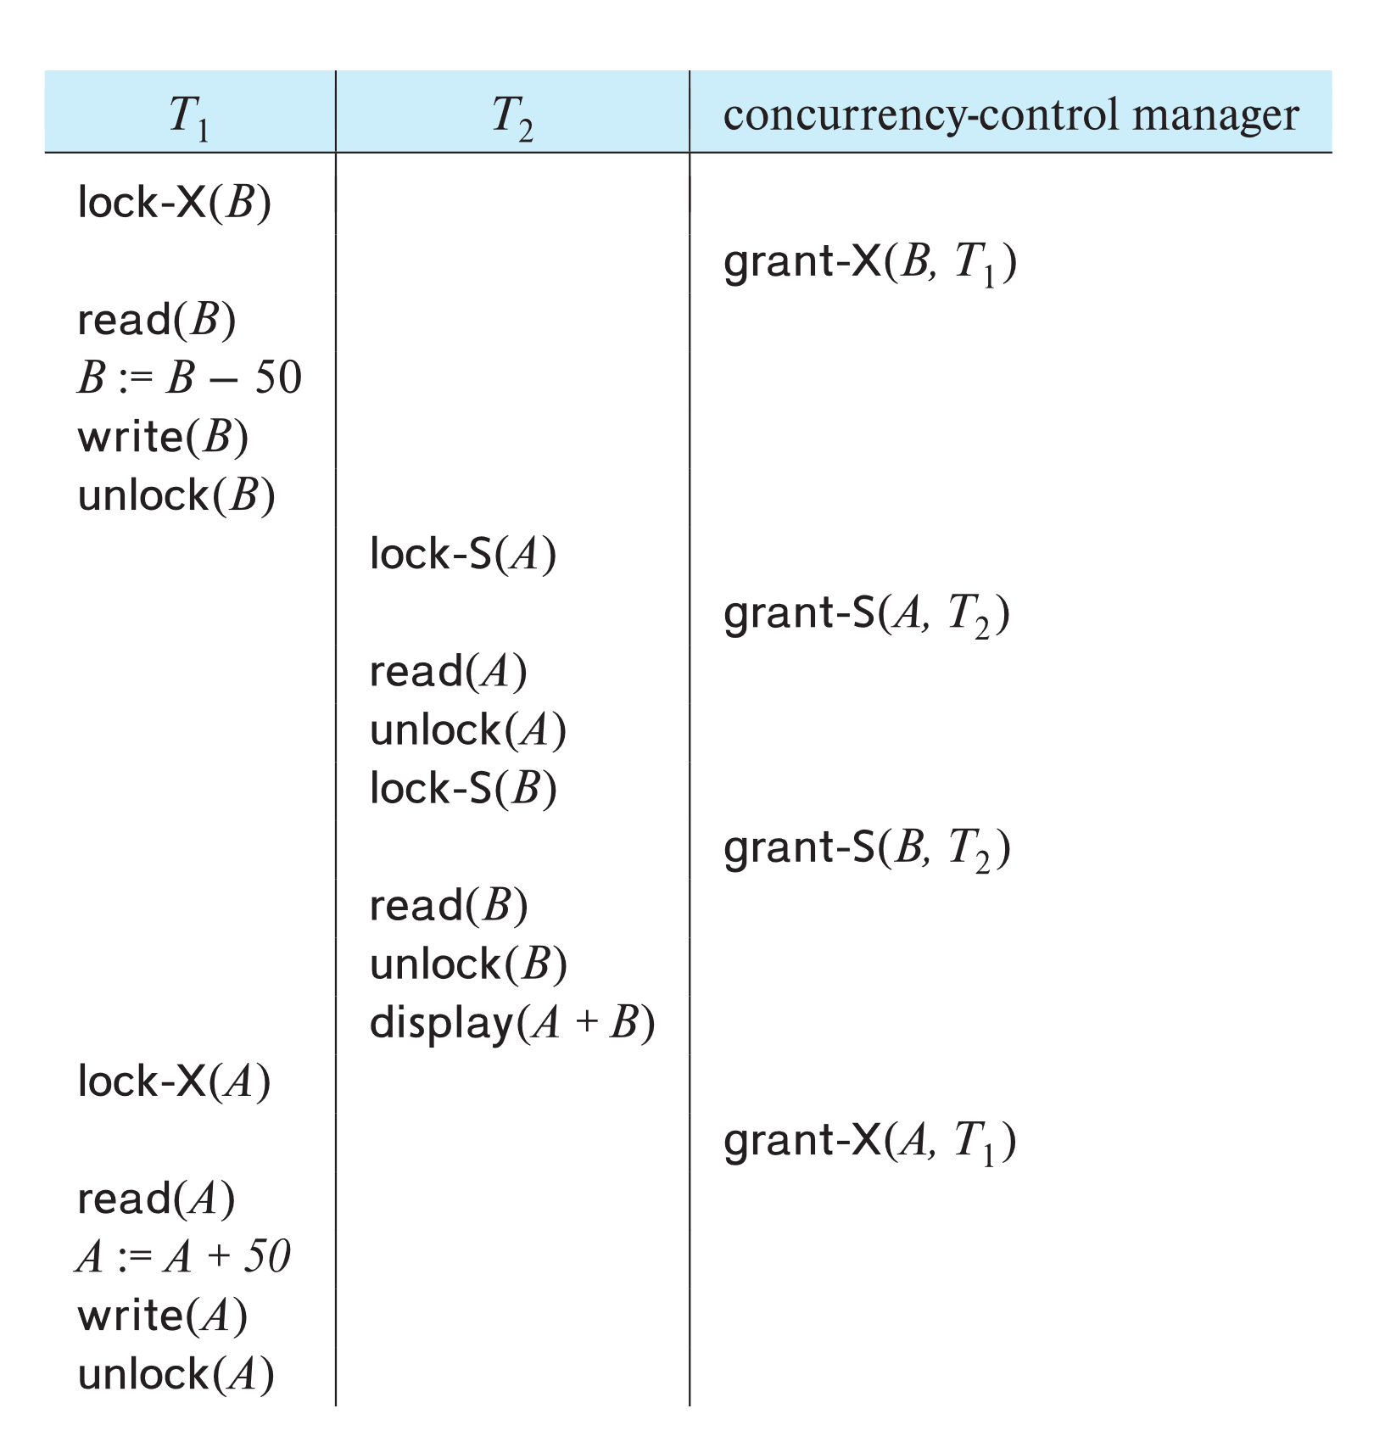
Schedule With Lock Grants
Grants omitted in rest of chapter
Assume grant happens just before the next instruction following lock request
This schedule is not serializable (why?)
A locking protocol is a set of rules followed by all transactions while requesting and releasing locks.
Locking protocols enforce serializability by restricting the set of possible schedules.

Slide 32
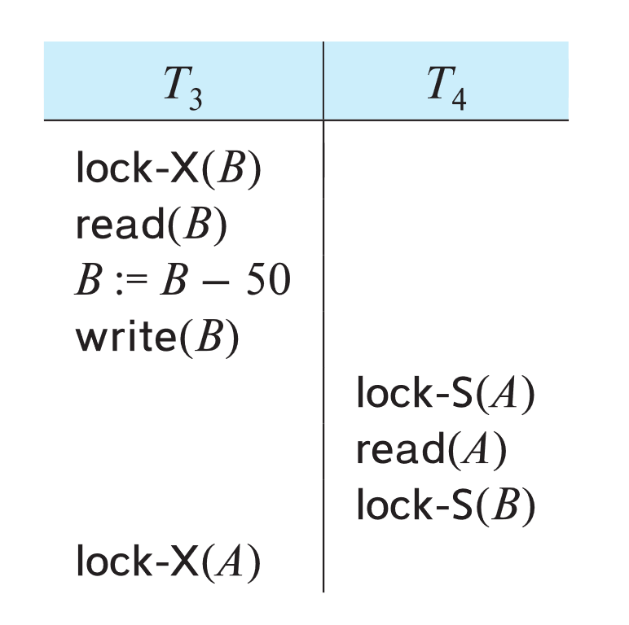
Deadlock
Locking can lead to an undesirable situation. For example, consider the partial schedule
Neither T₃ nor T₄ can make progress — executing lock-S(B) causes T₄ to wait for T₃ to release its lock on B, while executing lock-X(A) causes T₃ to wait for T₄ to release its lock on A.
Such a situation is called a deadlock.
To handle a deadlock one of T₃ or T₄ must be rolled back and its locks released.

Slide 33
Deadlock (Cont.)
The potential for deadlock exists in most locking protocols. Deadlocks are a necessary evil.
Starvation is also possible if concurrency control manager is badly designed. For example:
A transaction may be waiting for an X-lock on an item, while a sequence of other transactions request and are granted an S-lock on the same item.
The same transaction is repeatedly rolled back due to deadlocks.
Concurrency control manager can be designed to prevent starvation.
Starvation of transactions can be avoided by granting the locks as follows:
When T_{i} requests a lock on a data item Q in a particular mode M, the concurrency control manager grants the lock provided that
There is no other transaction holding a lock on Q in a mode that conflicts with M
There is no other transaction that is waiting for a lock on Q and that made its lock request before T_{i}

Slide 34
Two-Phase Locking
A widely used locking protocol, called Two-Phase Locking (2PL), has two rules:
Rule 1: if a transaction T wants to read (or write) an object O, it first requests the lock manager for a shared (or exclusive) lock on O
T0
T1
T2
T0
T1
T2
T0
T1
T2
Read Request on Object O
“Shared”
Lock Granted
Read Request on Object O
“Shared”
Lock Granted
Write Request on Object O
Lock Denied
Lock Manager
Lock Manager
Lock Manager
2
Queue
Queue
Queue
t0
t1
t2
Time
Notes:
In step 2, the combination of all Query optimization is one of the most important tasks of a relational DBMS
is used as a key for sorting.

Slide 35

Two-Phase Locking
A widely used locking protocol, called Two-Phase Locking (2PL), has two rules:
Rule 1: if a transaction T wants to read (or write) an object O, it first requests the lock manager for a shared (or exclusive) lock on O
T0
T1
T2
T0
T1
T2
T0
T1
T2
Release Lock on Object O
Release Lock on Object O
“Exclusive” Lock Granted
Lock Manager
Lock Manager
Lock Manager
2
2
2
Queue
Queue
Queue
t3
t4
t5
Time
Notes:
In step 2, the combination of all Query optimization is one of the most important tasks of a relational DBMS
is used as a key for sorting.

Slide 36
Two-Phase Locking
A widely used locking protocol, called Two-Phase Locking (2PL), has two rules:
Rule 1: if a transaction T wants to read (or write) an object O, it first requests the lock manager for a shared (or exclusive) lock on O
T0
T1
T2
T0
T1
T2
T0
T1
T2
Read Request on Object O
Release Lock on Object O
Read Request on Object O
Lock Denied
Lock Denied
Lock Manager
1
Lock Manager
Lock Manager
1
1
Queue
Queue
Queue
0
0
t6
t7
t8
Time
Notes:
In step 2, the combination of all Query optimization is one of the most important tasks of a relational DBMS
is used as a key for sorting.

Slide 37
Two-Phase Locking
A widely used locking protocol, called Two-Phase Locking (2PL), has two rules:
Rule 1: if a transaction T wants to read (or write) an object O, it first requests the lock manager for a shared (or exclusive) lock on O
T0
T1
T2
T0
T1
T2
T0
T1
T2
“Shared”
Lock Granted
“Shared”
Lock Granted
Write Request on Object O
Lock Denied
Lock Manager
1
Lock Manager
Lock Manager
2
0
Queue
Queue
Queue
0
t9
t9
t10
Time
Notes:
In step 2, the combination of all Query optimization is one of the most important tasks of a relational DBMS
is used as a key for sorting.

Slide 38
Two-Phase Locking
A widely used locking protocol, called Two-Phase Locking (2PL), has two rules:
Rule 2: T can release locks before it commits or aborts, and cannot request additional locks once it releases any lock
Thus, every transaction has a “growing” phase in which it acquires locks, followed by a “shrinking” phase in which it releases locks
# locks
growing phase
shrinking phase
Notes:
In step 2, the combination of all Query optimization is one of the most important tasks of a relational DBMS
is used as a key for sorting.

Slide 39
Two-Phase Locking
A widely used locking protocol, called Two-Phase Locking (2PL), has two rules:
Rule 2: T can release locks before it commits or aborts, and cannot request additional locks once it releases any lock
Thus, every transaction has a “growing” phase in which it acquires locks, followed by a “shrinking” phase in which it releases locks
# locks
violation of 2PL
Notes:
In step 2, the combination of all Query optimization is one of the most important tasks of a relational DBMS
is used as a key for sorting.

Slide 40
Resolving RW Conflicts Using 2PL
Suppose that T1 and T2 actions are interleaved as follows:
T1 reads A
T2 reads A, decrements A and commits
T1 tries to decrement A
T1 and T2 can be represented by the following schedule:
T1
T2
T1
T2
R(A)
W(A)
Commit
R(A)
W(A)
Commit
EXCLUSIVE(A)
R(A)
W(A)
Commit
RW Conflict Resolved!
Lock(A)
Wait
EXCLUSIVE(A)
R(A)
W(A)
Commit
Exposes RW Anomaly
Notes:
In step 2, the combination of all Query optimization is one of the most important tasks of a relational DBMS
is used as a key for sorting.

Slide 41
Resolving RW Conflicts Using 2PL
Suppose that T1 and T2 actions are interleaved as follows:
T1 reads A
T2 reads A, decrements A and commits
T1 tries to decrement A
T1 and T2 can be represented by the following schedule:
T1
T2
T1
T2
R(A)
W(A)
Commit
R(A)
W(A)
Commit
EXCLUSIVE(A)
R(A)
W(A)
Commit
But, it can limit parallelism!
Lock(A)
Wait
EXCLUSIVE(A)
R(A)
W(A)
Commit
Exposes RW Anomaly
Notes:
In step 2, the combination of all Query optimization is one of the most important tasks of a relational DBMS
is used as a key for sorting.

Slide 42
Resolving WW Conflicts Using 2PL
Suppose that T1 and T2 actions are interleaved as follows:
T1 sets Mohammad’s Salary to $1000
T2 sets Ahmad’s Salary to $2000
T1 sets Ahmad’s Salary to $1000
T2 sets Mohammad’s Salary to $2000
T1 and T2 can be represented by the following schedule:
T1
T2
T1
T2
EXCLUSIVE(MS)
EXCLUSIVE(AS)
W(MS)
W(AS)
Commit
WW Conflict Resolved!
W(MS)
W(AS)
Commit
W(AS)
W(MS)
Commit
Lock(AS)
Wait
EXCLUSIVE(AS)
EXCLUSIVE(MS)
W(AS)
W(MS)
Commit
Exposes WW Anomaly (assuming, MS & AS must be kept equal)
Notes:
In step 2, the combination of all Query optimization is one of the most important tasks of a relational DBMS
is used as a key for sorting.

Slide 43
Resolving WW Conflicts Using 2PL
Suppose that T1 and T2 actions are interleaved as follows:
T1 sets Mohammad’s Salary to $1000
T2 sets Ahmad’s Salary to $2000
T1 sets Ahmad’s Salary to $1000
T2 sets Mohammad’s Salary to $2000
T1 and T2 can be represented by the following schedule:
T1
T2
T1
T2
EXCLUSIVE(MS)
W(MS)
Lock(AS)
W(MS)
W(AS)
Commit
W(AS)
W(MS)
Commit
EXCLUSIVE(AS)
W(AS)
Lock(MS)
Wait
Wait
Exposes WW Anomaly (assuming, MS & AS must be kept equal)
Deadlock!
Notes:
In step 2, the combination of all Query optimization is one of the most important tasks of a relational DBMS
is used as a key for sorting.

Slide 44
Deadlock
Locking can lead to an undesirable situation. For example, consider the partial schedule
Neither T₃ nor T₄ can make progress — executing lock-S(B) causes T₄ to wait for T₃ to release its lock on B, while executing lock-X(A) causes T₃ to wait for T₄ to release its lock on A.
Such a situation is called a deadlock.
To handle a deadlock one of T₃ or T₄ must be rolled back and its locks released.

Slide 45
Deadlock (Cont.)
The potential for deadlock exists in most locking protocols. Deadlocks are a necessary evil.
Starvation is also possible if concurrency control manager is badly designed. For example:
A transaction may be waiting for an X-lock on an item, while a sequence of other transactions request and are granted an S-lock on the same item.
The same transaction is repeatedly rolled back due to deadlocks.
Concurrency control manager can be designed to prevent starvation.
Starvation of transactions can be avoided by granting the locks as follows:
When T_{i} requests a lock on a data item Q in a particular mode M, the concurrency control manager grants the lock provided that
There is no other transaction holding a lock on Q in a mode that conflicts with M
There is no other transaction that is waiting for a lock on Q and that made its lock request before T_{i}

Slide 46
Cascading rollback may occur under two-phase locking
T5 T6 T7
lock-X(A)
read(A)
lock-S(B)
read(B)
write(A)
unlock(A)
lock-X(A)
read(A)
write(A)
unlock(A)
lock-S(A)
read(A)
abort
Cascading rollback may occur under two-phase locking.

Slide 47
Resolving WR Conflicts
Suppose that T1 and T2 actions are interleaved as follows:
T1 deducts $100 from account A
T2 adds 6% interest to accounts A and B
T1 credits $100 to account B
T1 and T2 can be represented by the following schedule:
T1
T2
T1
T2
R(A)
W(A)
R(B)
W(B)
Commit
R(A)
W(A)
R(B)
W(B)
Commit
EXCLUSIVE(A)
EXCLUSIVE(B)
R(A)
W(A)
R(B)
W(B)
Commit
Lock(A)
WR Conflict Resolved!
EXCLUSIVE(A)
EXCLUSIVE(B)
R(A)
W(A)
R(B)
W(B)
Commit
Lock(B)
Wait
Exposes WR Anomaly
Notes:
In step 2, the combination of all Query optimization is one of the most important tasks of a relational DBMS
is used as a key for sorting.

Slide 48
Resolving WR Conflicts
Suppose that T1 and T2 actions are interleaved as follows:
T1 deducts $100 from account A
T2 adds 6% interest to accounts A and B
T1 credits $100 to account B
T1 and T2 can be represented by the following schedule:
T1
T2
T1
T2
R(A)
W(A)
R(B)
W(B)
Commit
R(A)
W(A)
R(B)
W(B)
Commit
EXCLUSIVE(A)
EXCLUSIVE(B)
R(A)
W(A)
RELEASE(A)
R(B)
W(B)
Commit
EXCLUSIVE(A)
R(A)
W(A)
EXCLUSIVE(B)
R(B)
W(B)
Commit
WR Conflict is NOT Resolved!
Lock(A)
Lock(B)
Wait
How can we solve this?
Exposes WR Anomaly
Notes:
In step 2, the combination of all Query optimization is one of the most important tasks of a relational DBMS
is used as a key for sorting.

Slide 49
Strict Two-Phase Locking
WR conflicts (as well as RW & WW) can be solved by making 2PL stricter
In particular, Rule 2 in 2PL can be modified as follows:
Rule 2: locks of a transaction T can only be released after T completes (i.e., commits or aborts)
This version of 2PL is called Strict Two-Phase Locking
Notes:
In step 2, the combination of all Query optimization is one of the most important tasks of a relational DBMS
is used as a key for sorting.

Slide 50
Resolving WR Conflicts: Revisit
Suppose that T1 and T2 actions are interleaved as follows:
T1 deducts $100 from account A
T2 adds 6% interest to accounts A and B
T1 credits $100 to account B
T1 and T2 can be represented by the following schedule:
T1
T2
T1
T2
R(A)
W(A)
R(B)
W(B)
Commit
R(A)
W(A)
R(B)
W(B)
Commit
EXCLUSIVE(A)
EXCLUSIVE(B)
R(A)
W(A)
RELEASE(A)
R(B)
W(B)
Commit
EXCLUSIVE(A)
R(A)
W(A)
EXCLUSIVE(B)
R(B)
W(B)
Commit
Lock(A)
Lock(B)
Wait
Exposes WR Anomaly
Not allowed with strict 2PL
Notes:
In step 2, the combination of all Query optimization is one of the most important tasks of a relational DBMS
is used as a key for sorting.

Slide 51
Resolving WR Conflicts: Revisit
Suppose that T1 and T2 actions are interleaved as follows:
T1 deducts $100 from account A
T2 adds 6% interest to accounts A and B
T1 credits $100 to account B
T1 and T2 can be represented by the following schedule:
T1
T2
T1
T2
R(A)
W(A)
R(B)
W(B)
Commit
WR Conflict is Resolved!
R(A)
W(A)
R(B)
W(B)
Commit
EXCLUSIVE(A)
EXCLUSIVE(B)
R(A)
W(A)
R(B)
W(B)
Commit
Lock(A)
EXCLUSIVE(A)
EXCLUSIVE(B)
R(A)
W(A)
R(B)
W(B)
Commit
Lock(B)
Wait
But, parallelism is limited more!
Exposes WR Anomaly
Notes:
In step 2, the combination of all Query optimization is one of the most important tasks of a relational DBMS
is used as a key for sorting.

Slide 52
2PL vs. Strict 2PL
T1
T2
Two-Phase Locking (2PL):
Limits concurrency
May lead to deadlocks
May have ‘dirty reads’
Strict 2PL:
Limits concurrency more (but, actions of different transactions can still be interleaved)
May still lead to deadlocks
Avoids ‘dirty reads’
SHARED(A)
R(A)
EXCLUSIVE(C)
R(C)
W(C)
Commit
SHARED(A)
R(A)
EXECLUSIVE(B)
R(B)
W(B)
Commit
A Schedule with Strict 2PL and Interleaved Actions

Slide 53
Schedules with Aborted Transactions
Suppose that T1 and T2 actions are interleaved as follows:
T1 deducts $100 from account A
T2 adds 6% interest to accounts A and B, and commits
T1 is aborted
T1 and T2 can be represented by the following schedule:
T1
T2
R(A)
W(A)
Abort
R(A)
W(A)
R(B)
W(B)
Commit
T2 read a value for A that should have never been there!
How can we deal with the situation, assuming T2 had not yet committed?
Notes:
In step 2, the combination of all Query optimization is one of the most important tasks of a relational DBMS
is used as a key for sorting.

Slide 54
Schedules with Aborted Transactions
Suppose that T1 and T2 actions are interleaved as follows:
T1 deducts $100 from account A
T2 adds 6% interest to accounts A and B, and commits
T1 is aborted
T1 and T2 can be represented by the following schedule:
T1
T2
R(A)
W(A)
Abort
R(A)
W(A)
R(B)
W(B)
Commit
T2 read a value for A that should have never been there!
We can cascade the abort of T1 by aborting T2 as well!
This “cascading process” can be recursively applied to any transaction that read A written by T1
Notes:
In step 2, the combination of all Query optimization is one of the most important tasks of a relational DBMS
is used as a key for sorting.

Slide 55
Schedules with Aborted Transactions
Suppose that T1 and T2 actions are interleaved as follows:
T1 deducts $100 from account A
T2 adds 6% interest to accounts A and B, and commits
T1 is aborted
T1 and T2 can be represented by the following schedule:
T1
T2
R(A)
W(A)
Abort
R(A)
W(A)
R(B)
W(B)
Commit
T2 read a value for A that should have never been there!
How can we deal with the situation, assuming T2 had actually committed?
The schedule is indeed unrecoverable!
Notes:
In step 2, the combination of all Query optimization is one of the most important tasks of a relational DBMS
is used as a key for sorting.

Slide 56
Schedules with Aborted Transactions
Suppose that T1 and T2 actions are interleaved as follows:
T1 deducts $100 from account A
T2 adds 6% interest to accounts A and B, and commits
T1 is aborted
T1 and T2 can be represented by the following schedule:
T1
T2
R(A)
W(A)
Abort
R(A)
W(A)
R(B)
W(B)
Commit
T2 read a value for A that should have never been there!
For a schedule to be recoverable, transactions should commit only after all transactions whose changes they read commit!
“Recoverable schedules” avoid cascading aborts!
Notes:
In step 2, the combination of all Query optimization is one of the most important tasks of a relational DBMS
is used as a key for sorting.

Slide 57
Schedules with Aborted Transactions
Suppose that T1 and T2 actions are interleaved as follows:
T1 deducts $100 from account A
T2 adds 6% interest to accounts A and B, and commits
T1 is aborted
T1 and T2 can be represented by the following schedule:
T1
T2
R(A)
W(A)
Abort
R(A)
W(A)
R(B)
W(B)
Commit
T2 read a value for A that should have never been there!
How can we ensure “recoverable schedules”?
By using Strict 2PL!
Notes:
In step 2, the combination of all Query optimization is one of the most important tasks of a relational DBMS
is used as a key for sorting.

Slide 58
Schedules with Aborted Transactions
Suppose that T1 and T2 actions are interleaved as follows:
T1 deducts $100 from account A
T2 adds 6% interest to accounts A and B, and commits
T1 is aborted
T1 and T2 can be represented by the following schedule:
T1
T2
T1
T2
EXCLUSIVE(A)
R(A)
W(A)
Abort
UNDO(T1)
EXCLUSIVE(A)
R(A)
W(A)
EXCLUSIVE(B)
R(B)
W(B)
Commit
Cascaded aborts are avoided!
R(A)
W(A)
Abort
R(A)
W(A)
R(B)
W(B)
Commit
Lock(A)
Wait
Notes:
In step 2, the combination of all Query optimization is one of the most important tasks of a relational DBMS
is used as a key for sorting.

Slide 59
Serializable Schedules: Redefined
Two schedules are said to be equivalent if for any database state, the effect of executing the 1st schedule is identical to the effect of executing the 2nd schedule
Previously: a serializable schedule is a schedule that is equivalent to a serial schedule
Now: a serializable schedule is a schedule that is equivalent to a serial schedule over a set of committed transactions
This definition captures serializability as well as recoverability
Notes:
In step 2, the combination of all Query optimization is one of the most important tasks of a relational DBMS
is used as a key for sorting.

Slide 60
Lock Conversions
A transaction may need to change the lock it already acquires on an object
From Shared to Exclusive
This is referred to as lock upgrade
From Exclusive to Shared
This is referred to as lock downgrade
For example, an SQL update statement might acquire a Shared lock on each row, R, in a table and if R satisfies the condition (in the WHERE clause), an Exclusive lock must be obtained for R

Slide 61
Lock Upgrades
A lock upgrade request from a transaction T on object O must be handled specially by:
Granting an Exclusive lock to T immediately if no other transaction holds a lock on O
Otherwise, queuing T at the front of O’s queue (i.e., T is favored)
T is favored because it already holds a Shared lock on O
Queuing T in front of another transaction T’ that holds no lock on O, but requested an Exclusive lock on O averts a deadlock!
However, if T and T’ hold a Shared lock on O, and both request upgrades to an Exclusive lock, a deadlock will arise regardless!

Slide 62
Lock Downgrades
Lock upgrades can be entirely avoided by obtaining Exclusive locks initially, and downgrade them to Shared locks once needed
Would this violate any 2PL requirement?
On the surface yes; since the transaction (say, T) may need to upgrade later
This is a special case as T conservatively obtained an Exclusive lock, and did nothing but read the object that it downgraded
2PL can be safely extended to allow lock downgrades in the growing phase, provided that the transaction has not modified the object

Slide 63
Deadlock Detection
The lock manager maintains a structure called a waits-for graph to periodically detect deadlocks
In a waits-for graph:
The nodes correspond to active transactions
There is an edge from Ti to Tj if and only if Ti is waiting for Tj to release a lock
The lock manager adds and removes edges to and from a waits-for graph when it queues and grants lock requests, respectively
A deadlock is detected when a cycle in the waits-for graph is found

Slide 64
Deadlock Detection (Cont’d)
The following schedule is free of deadlocks:
T1
T2
T3
T4
S(A)
R(A)
S(B)
X(B)
T1
T2
X(B)
W(B)
X(C)
S(C)
R(C)
T4
T3
No cycles; hence, no deadlocks!
A schedule without a deadlock
The Corresponding Waits-For Graph*
*The nodes correspond to active transactions and there is an edge from Ti to Tj if and only if Ti is waiting for Tj to release a lock

Slide 65
Deadlock Detection (Cont’d)
The following schedule is NOT free of deadlocks:
T1
T2
T3
T4
S(A)
R(A)
S(B)
X(B)
T1
T2
X(B)
W(B)
X(C)
S(C)
R(C)
X(A)
T4
T3
A schedule with a deadlock
The Corresponding Waits-For Graph*
*The nodes correspond to active transactions and there is an edge from Ti to Tj if and only if Ti is waiting for Tj to release a lock

Slide 66
Deadlock Detection (Cont’d)
The following schedule is NOT free of deadlocks:
T1
T2
T3
T4
S(A)
R(A)
S(B)
X(B)
T1
T2
X(B)
W(B)
X(C)
S(C)
R(C)
X(A)
T4
T3
Cycle detected; hence, a deadlock!
A schedule with a deadlock
The Corresponding Waits-For Graph*
*The nodes correspond to active transactions and there is an edge from Ti to Tj if and only if Ti is waiting for Tj to release a lock

Slide 67
Resolving Deadlocks
A deadlock is resolved by aborting a transaction that is on a cycle and releasing its locks
This allows some of the waiting transactions to proceed
The choice of which transaction to abort can be made using different criteria:
The one with the fewest locks
Or the one that has done the least work
Or the one that is farthest from completion (more accurate)
Caveat: a transaction that was aborted in the past, should be favored subsequently and not aborted upon a deadlock detection!

Slide 68
Deadlock Prevention
Studies indicate that deadlocks are relatively infrequent and detection-based schemes work well in practice
However, if there is a high level of contention for locks, prevention-based schemes could perform better
Deadlocks can be averted by giving each transaction a priority and ensuring that lower-priority transactions are not allowed to wait for higher-priority ones (or vice versa)

Slide 69
Deadlock Prevention (Cont’d)
One way to assign priorities is to give each transaction a timestamp when it is started
Thus, the lower the timestamp, the higher is the transaction’s priority
If a transaction Ti requests a lock and a transaction Tj holds a conflicting lock, the lock manager can use one of the following policies:
Wound-Wait: If Ti has higher priority, Tj is aborted; otherwise, Ti waits
Wait-Die: If Ti has higher priority, it is allowed to wait; otherwise, it is aborted

Slide 70
Reissuing Timestamps
A subtle point is that we must ensure that no transaction is perennially aborted because it never had a sufficiently high priority
To avoid that, when a transaction is aborted and restarted, it should be given the same timestamp it had originally
This policy is referred to as reissuing timestamps
Reissuing timestamps ensures that each transaction will eventually become the oldest and accordingly get all the locks it requires!

